Slide 1
University of barishal

Slide 2

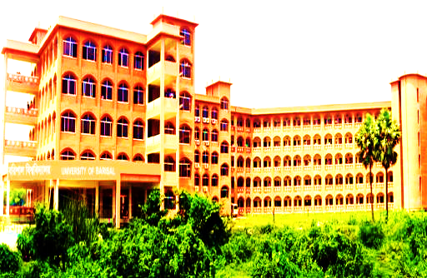
University of Barishal
University of Barishal is a University in south part of Bangladesh.

Slide 3
University of Barishal
University of Barishal is a top ten university in Bangladesh and there are more then 8000 running students here.

Slide 4
University of Barishal
University of Barishal came into existence in 2011 with some department ,teachers, students .Now it is one of the popular University.

Slide 5
University of Barishal
There are only two University in whole Barishal Division..

Slide 6
University of Barishal
There are many rivers in Barishal around this area there are six District .Across the country many students have come here achieve higher education .

Slide 7
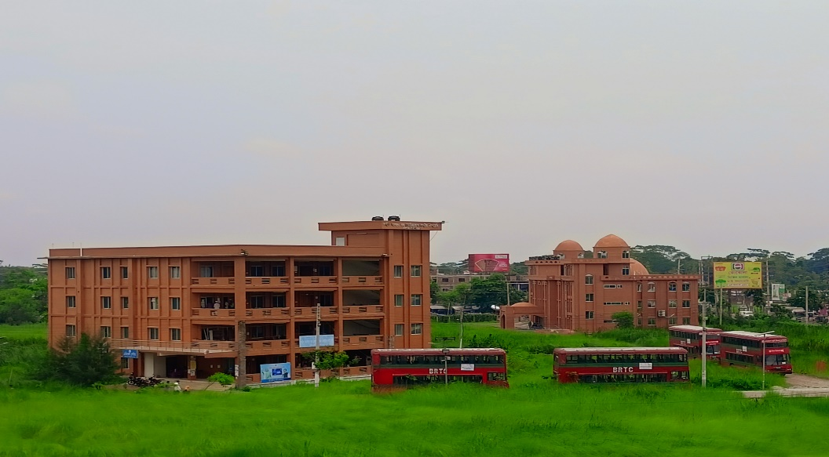
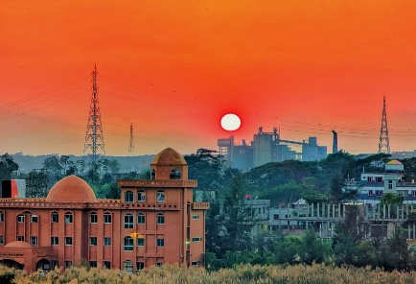


University of Barishal
Central Library
Central Mosque
University of Barishal

Slide 8
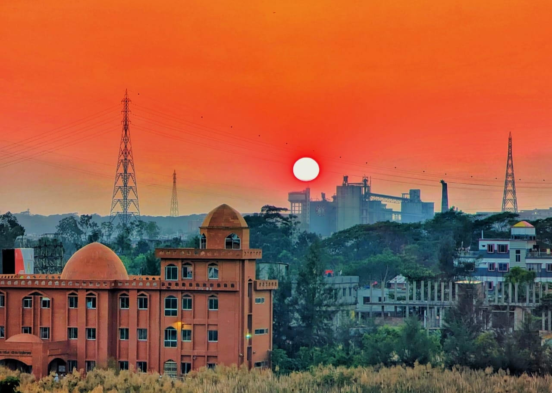
University of Barishal
Central Mosque
University of Barishal
Bus ,University of_Barishal

Slide 9


University of Barishal
Central Mosque
University of Barishal
Logo ,University of_Barishal

Slide 10
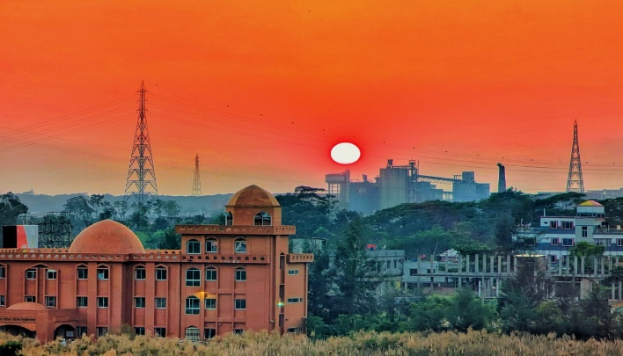
University of Barishal
University of Barishal
Logo ,University of_Barishal

Slide 11
University of Barishal
Logo ,University of_Barishal
THE END
Thanks you all

